Slide 1

AIDS

Slide 2
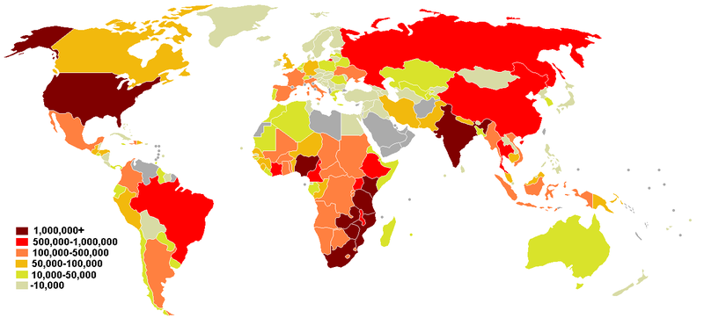
What is your issue?
HIV/AIDS

Slide 3

What is happening with my issue in the Middle East?
Aids never use to be a huge problem in the Middle East until the current up rise in premarital sex and recreational drug use.

Slide 4
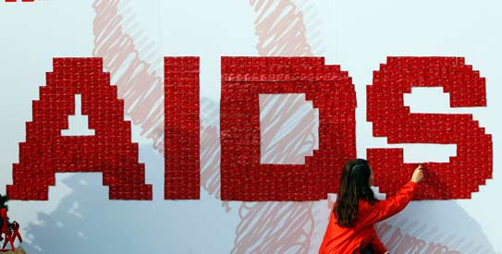
What is United Nations doing for your issue?
The UN has set up an organization called UNAID or Joint United Nations figh against HIV/AIDS.
They have set these goals
  Reduce sexual transmission of HIV by 50% by 2015.
  Reduce transmission of HIV among people who inject drugs by 50% by 2015.
  Eliminate new HIV infections among children by 2015 and substantially reduce AIDS-related maternal deaths

Slide 5

What is the future for AIDS in the Middle East?
The future of AIDS is being resolved through education of the risk and condom use. Also clinics are being used to help keep AIDS infections down. The UN is making large strides towards zero aids.

Slide 6
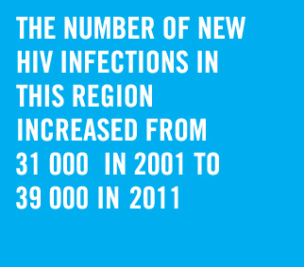

Slide 7
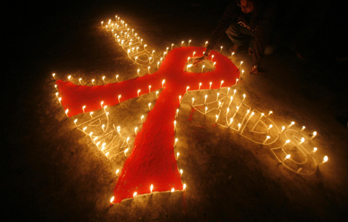

Slide 8
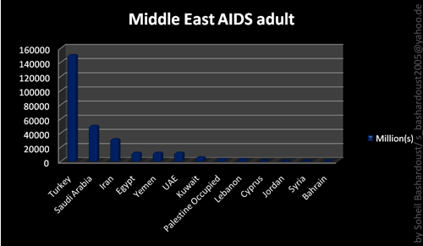

Slide 9
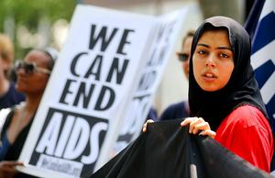

Slide 10

THE END

