Slide 1
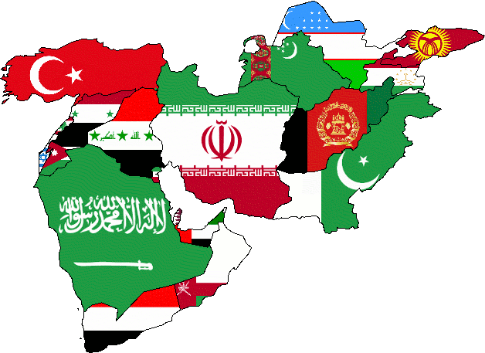
Middle Eastern Countries

Slide 2

Tunisia
Street protests began in Tunis in December 2010 over high unemployment, corruption, widespread poverty, and high food prices escalated in January 2011, culminating in rioting that led to hundreds of deaths. On 14 January 2011, the same day BEN ALI dismissed the government, he fled the country, and by late January 2011, a "national unity government" was formed. Elections for the new Constituent Assembly were held in late October 2011, and in December, it elected human rights activist Moncef Marzouki as interim president. The Assembly began drafting a new constitution in February 2012, and released a second working draft in December 2012. The interim government has proposed presidential and parliamentary elections be held in 2013.

Slide 3

Algeria
The government in 2011 introduced some political reforms in response to the Arab Spring, including lifting the 19-year-old state of emergency restrictions and increasing women's quotas for elected assemblies. Parliamentary elections in May 2012 and municipal and provinicial elections in November 2012 saw continued dominance by the FLN, with Islamist opposition parties performing poorly. Political protest activity in the country remained low in 2012, but small, sometimes violent socioeconomic demonstrations by disparate groups continued to be a common occurrence. Parliament in 2013 is expected to revise the constitution.

Slide 4

Egypt
Beginning in January 2011 in the wake of unrest in Tunisia and Egypt, as many as several thousand Jordanians staged weekly demonstrations and marches in Amman and other cities throughout Jordan to push for political reforms and protest against government corruption, rising prices, rampant poverty, and high unemployment. A royal decree issued in September 2011 approved constitutional amendments passed by the Parliament aimed at strengthening a more independent judiciary and established a constitutional court and independent election commission to oversee municipal and parliamentary elections. In October 2011, King ABDALLAH dismissed the Jordanian cabinet and replaced the prime minister in response to widespread public dissatisfaction with government performance and escalating criticism of the premier because of public concerns over his reported involvement in corruption. Parliamentary elections held in January 2013 were overseen by the newly established Independent Electoral Commission and resulted in the election of 150 members to the Lower House of Parliament.

Slide 5
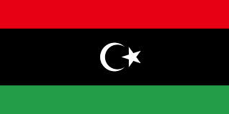
Libya
In response to QADHAFI's harsh military crackdown on protesters, the UN Security Council adopted Resolution 1973, which demanded an immediate ceasefire and authorized the international community to establish a no-fly zone over Libya. After several months of see-saw fighting, anti-QADHAFI forces in August 2011 captured the capital, Tripoli. In mid-September, the UN General Assembly voted to recognize the TNC as the legitimate interim governing body of Libya. The TNC on 23 October officially declared the country liberated following the defeat of the last remaining pro-QADHAFI stronghold and QADHAFI's death. In July 2012, Libya held its first post-QADHAFI nationwide election, which resulted in the formation of a 200-member National Congress (NC). In August 2012, the NC elected a congress president and in October, a new prime minister.

Slide 6

Syria
International pressure on the ASAD regime has intensified since late 2011 as the Arab League, EU, Turkey, and the United States have expanded economic sanctions against the regime. Lakhdar BRAHIMI, current Joint Special Representative of the United Nations and the League of Arab States on the Syrian crisis, in October 2012 began meeting with regional heads of state to assist in brokering a cease-fire. In December 2012, the National Coalition of Syrian Revolution and Opposition Forces was recognized by more than 130 countries as the sole legitimate representative of the Syrian people. Unrest persists in 2013,and the death toll among Syrian government forces, Opposition Forces, and civilians has topped 60,000.

Slide 7

Saudi Arabia
During 2012, Shia protests increased in violence, while peaceful Sunni protests expanded. The country remains a leading producer of oil and natural gas and holds more than 20% of the world's proven oil reserves. The government continues to pursue economic reform and diversification, particularly since Saudi Arabia's accession to the WTO in December 2005, and promotes foreign investment in the kingdom. A burgeoning population, aquifer depletion, and an economy largely dependent on petroleum output and prices are all ongoing governmental concerns.

Slide 8
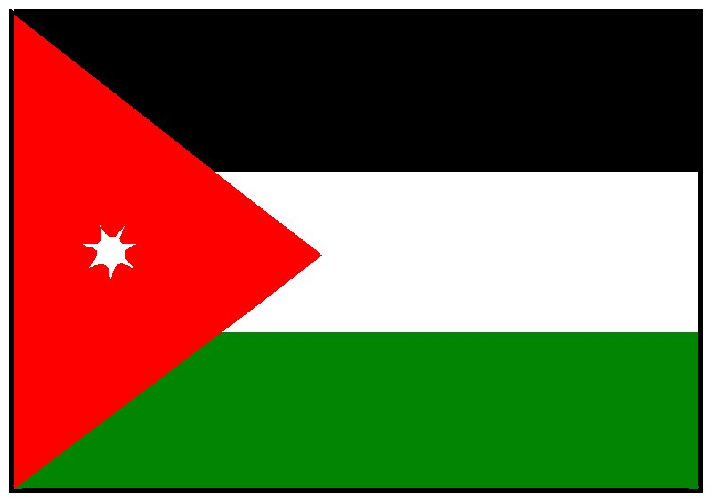
Jordan
A royal decree issued in September 2011 approved constitutional amendments passed by the Parliament aimed at strengthening a more independent judiciary and established a constitutional court and independent election commission to oversee municipal and parliamentary elections. In October 2011, King ABDALLAH dismissed the Jordanian cabinet and replaced the prime minister in response to widespread public dissatisfaction with government performance and escalating criticism of the premier because of public concerns over his reported involvement in corruption. Parliamentary elections held in January 2013 were overseen by the newly established Independent Electoral Commission and resulted in the election of 150 members to the Lower House of Parliament.

Slide 9
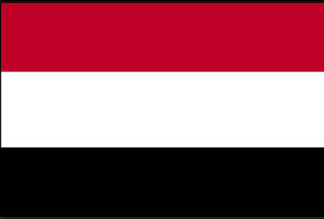
Yemen
The Gulf Cooperation Council (GCC) in late April 2011, in an attempt to mediate the crisis in Yemen, proposed an agreement in which the president would step down in exchange for immunity from prosecution. SALIH's refusal to sign an agreement led to heavy street fighting and his injury in an explosion in June 2011. The UN Security Council passed Resolution 2014 in October 2011 calling on both sides to end the violence and complete a power transfer deal. In late November 2011, President SALIH signed the GCC-brokered agreement to step down and to transfer some of his powers to Vice President Abd Rabuh Mansur HADI. Following elections in February 2012, won by HADI, SALIH formally transferred his powers.

Slide 10
My Country
If the United States government got involved in Syria's issues we would slow down the death of all the government and civilian forces.

